Slide 1



JAVA 8 workshop
Ido Barash

Slide 2

Agenda
Introduction to Java 8
Default methods
Functional Programing
Lambdas
methods as references
Functional Interfaces
FP with streams
Optionals
Extras (Date/Time and bye-bye PermGen).

Slide 3

Introduction to java 8
From Java 1.5, there weren't any major changes with the Java language.
Trends like “functional programming” and “lambda expressions” became more common and the Java’s “ignoring strategy” was proven wrong.
Scala grew more successful and started to challenge Java.
The language must go on.

Slide 4
Introduction to java 8
What is new?
Default interface methods implementation.
New Date time API.
New JS engine.
Lambda expressions support.
Method references.
New collections streams API (including built-in parallel processing).
Optionals
JVM inhancements (PermGen removed, and small VM).

Slide 5
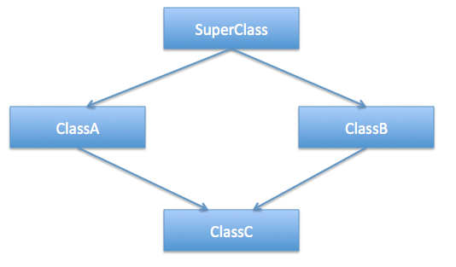
Default Methods

Slide 6
Default Methods
Till java 8, multiple inheritance was not supported.
Why doesn’t Java support multiple inheritance?
For the sake of simplicity
Complicates the design
Constructor chaining
The diamond problem

Slide 7
Default Methods
Till java 8, multiple inheritance was not supported.
Why doesn’t Java support multiple inheritance?
For the sake of simplicity
Complicates the design
Constructor chaining
The diamond problem
A
()F
()override F
B
C
()Inherit F
D
? ()F

Slide 8
Default Methods
By using interfaces, Java allowed some sort of multiple inheritance.
Interfaces are just a bunch of declarations – they does not allow any implementation of a default method body.

Slide 9
Default Methods
By using interfaces, Java allowed some sort of multiple inheritance.
Interfaces are just a bunch of declarations – they does not allow any implementation of a default method body.
This solves the diamond problem - ambiguity methods implementations.

Slide 10
Default Methods
Java 8 has a new feature: Interfaces with default methods.

Slide 11
Default Methods
Java 8 has a new feature: Interfaces with default methods.
public interface A {
public default void doSomething() {
System.out.println("default implementation");
}
}

Slide 12
Default Methods
Java 8 has a new feature: Interfaces with default methods.
public interface A {
public default void doSomething() {
System.out.println("default implementation");
}
}
Using the word default we can declare a default implementation That will be chosen if the implementing class did not provide an implementation of it’s own

Slide 13
Default Methods
Java 8 has a new feature: Interfaces with default methods.
public interface A {
public default void doSomething() {
System.out.println("default implementation");
}
}
public class Student implements A {
}

Slide 14
Default Methods
Java 8 has a new feature: Interfaces with default methods.
public interface A {
public default void doSomething() {
System.out.println("default implementation");
}
}
public class Student implements A {
}
public static void main(String[] args) {
Student student = new Student();
student.doSomething();
}

Slide 15
Default Methods
Java 8 has a new feature: Interfaces with default methods.
public interface A {
public default void doSomething() {
System.out.println("default implementation");
}
}
public class Student implements A {
}
public static void main(String[] args) {
Student student = new Student();
student.doSomething();
}
()No implementation of A.doSomething

Slide 16
Default Methods
An interface method with a default implementation is called: Defender-method or Virtual extension method.

Slide 17
Default Methods
An interface method with a default implementation is called: Defender-method or Virtual extension method.
public interface A {
public default void doSomething() {
System.out.println("default implementation");
}
public void doSomethingElse();
}

Slide 18
Default Methods
An interface method with a default implementation is called: Defender-method or Virtual extension method.
public interface A {
public default void doSomething() {
System.out.println("default implementation");
}
public void doSomethingElse();
}
Defender method

Slide 19
Default Methods
An interface method with a default implementation is called: Defender-method or Virtual extension method.
public interface A {
public default void doSomething() {
System.out.println("default implementation");
}
public void doSomethingElse();
}
public class Student implements A {
@Override
public void doSomethingElse() {
System.out.println("Something else");
}
}

Slide 20
Default Methods
So what about the diamond problem and multiple inheritance:

Slide 21
Default Methods
So what about the diamond problem and multiple inheritance:
The chosen implementation will be the closest one in the hierarchy level.

Slide 22
Default Methods
So what about the diamond problem and multiple inheritance:
The chosen implementation will be the closest one in the hierarchy level.
A
()F
C
()override F
()override F
B
D
E
()F() == B.F

Slide 23
Default Methods
What if two implementations are at the same level?

Slide 24
Default Methods
What if two implementations are at the same level?
public interface A {
public default void doSomething() {
System.out.println("A: default implementation");
}
}
public interface B {
public default void doSomething() {
System.out.println(“B: default implementation");
}
}
public class Student implements A, B {
}

Slide 25
Default Methods
What if two implementations are at the same level?
public interface A {
public default void doSomething() {
System.out.println("A: default implementation");
}
}
public interface B {
public default void doSomething() {
System.out.println(“B: default implementation");
}
}
public class Student implements A, B {
}
Which will be chosen?

Slide 26
Default Methods
What if two implementations are at the same level?
public class Student implements A, B {
}
None! We will have to provide an implementation for the ambiguous method in the implementing class.

Slide 27
Default Methods
What if two implementations are at the same level?
public class Student implements A, B {
}
None! We will have to provide an implementation for the ambiguous method in the implementing class:
public class Student implements A, B {
@Override
public void doSomething() {
}
}
public class Student implements A, B {
@Override
public void doSomething() {
A.super.doSomething();
}
}

Slide 28
Default Methods
Why do we need default methods?! We managed just fine without them for a long time.

Slide 29
Default Methods
Why do we need default methods?! We managed just fine without them for a long time.
Interfaces are coupled with implementing classes. It is impossible to add a method to an interface without harming all it’s implementers.
Java 8 presents a lot of new functionality, especially with collections and lambda expressions. In order to provide backward compatibility – default methods are needed.

Slide 30
Default Methods
Interfaces with default methods vs abstract class:
Default methods cannot be constructors
Interfaces with Default methods cannot have members
Default methods cannot hold an object’s state.
Default methods are mostly there for backward compatibility.

Slide 31

Functional Programming

Slide 32
Functional Programming
Functional programing is an ongoing trend in the programming world, that cannot be ignored.
In the Java world, only primitives can exist outside an object scope.
But FP is all about functions.

Slide 33
Functional Programming
Functional programing is an ongoing trend in the programming world, that cannot be ignored.
In the Java world, only primitives can exist outside an object scope.
But FP is all about functions.
We cannot define a method that is alive all by itself.
We cannot pass a method as an argument to another method.

Slide 34
Functional Programming
Java 8 presents some new ways to overcome these problems (at least partially) with new syntax and new capabilities:

Slide 35
Functional Programming
Java 8 presents some new ways to overcome these problems (at least partially) with new syntax and new capabilities:
Lambda expressions
Method references
Streams

Slide 36

FP - Lambdas
Our inventory = List of Apples

Slide 37
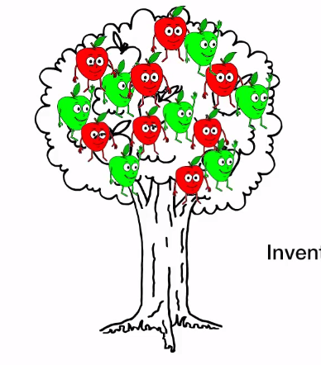
FP - Lambdas
Our inventory = List of Apples
public class Apple {
private String color;
private int weight;
public String getColor() {...}
public void setColor(String color) {...}
public int getWeight() {...}
public void setWeight(int weight) {...}
}

Slide 38
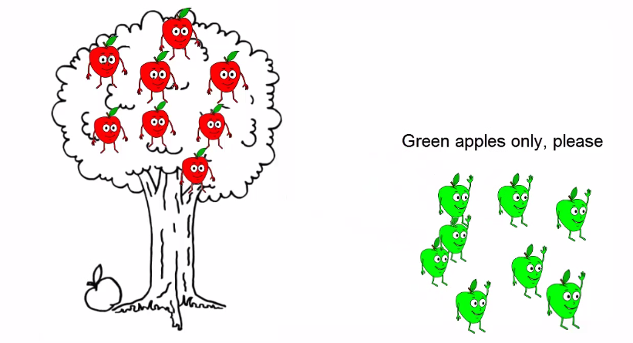

FP - Lambdas
Green apples only please:

Slide 39
FP - Lambdas
Green apples only please:
public static List<Apple> filterGreenApples(List<Apple> inventory) {
List<Apple> result = new ArrayList<>();
for (Apple apple : inventory) {
if (apple.getColor().equals("green")) {
result.add(apple);
}
}
return result;
}

Slide 40
FP - Lambdas
Green apples only please:
public static List<Apple> filterGreenApples(List<Apple> inventory) {
List<Apple> result = new ArrayList<>();
for (Apple apple : inventory) {
if (apple.getColor().equals("green")) {
result.add(apple);
}
}
return result;
}
Start empty add green apples one by one

Slide 41
FP - Lambdas
Green apples only please:
public static List<Apple> filterGreenApples(List<Apple> inventory) {
List<Apple> result = new ArrayList<>();
for (Apple apple : inventory) {
if (apple.getColor().equals("green")) {
result.add(apple);
}
}
return result;
}
Select only green apples

Slide 42

FP - Lambdas
Now, heavy apples please:

Slide 43
FP - Lambdas
Now, heavy apples please:
public static List<Apple> filterHeavyApples(List<Apple> inventory) {
List<Apple> result = new ArrayList<>();
for (Apple apple : inventory) {
if (apple.getWeight() > 150) {
result.add(apple);
}
}
return result;
}

Slide 44
FP - Lambdas
Now, heavy apples please:
public static List<Apple> filterHeavyApples(List<Apple> inventory) {
List<Apple> result = new ArrayList<>();
for (Apple apple : inventory) {
if (apple.getWeight() > 150) {
result.add(apple);
}
}
return result;
}
Copy&paste And only change the predicate

Slide 45
FP - Lambdas
What is the difference?!
public static List<Apple> filterGreenApples(List<Apple> inventory) {
List<Apple> result = new ArrayList<>();
for (Apple apple : inventory) {
if (apple.getColor().equals("green")) {
result.add(apple);
}
}
return result;
}
public static List<Apple> filterHeavyApples(List<Apple> inventory) {
List<Apple> result = new ArrayList<>();
for (Apple apple : inventory) {
if (apple.getWeight() > 150) {
result.add(apple);
}
}
return result;
}

Slide 46
FP - Lambdas
What is the difference?!
public static List<Apple> filterGreenApples(List<Apple> inventory) {
List<Apple> result = new ArrayList<>();
for (Apple apple : inventory) {
if (apple.getColor().equals("green")) {
result.add(apple);
}
}
return result;
}
public static List<Apple> filterHeavyApples(List<Apple> inventory) {
List<Apple> result = new ArrayList<>();
for (Apple apple : inventory) {
if (apple.getWeight() > 150) {
result.add(apple);
}
}
return result;
}

Slide 47
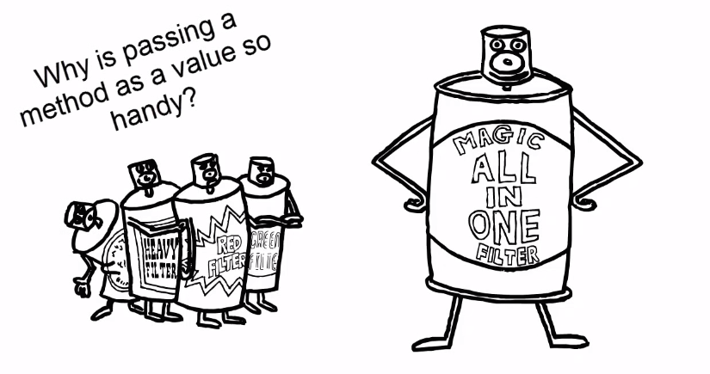
FP - Lambdas
Why is passing a method as a value is so handy?

Slide 48
FP - Lambdas
Why is passing a method as a value is so handy?
public static List<Apple> filterApples(List<Apple> inventory, Predicate<Apple> predicate) {
List<Apple> result = new ArrayList<>();
for (Apple apple: inventory) {
if (predicate.test(apple)) {
result.add(apple);
}
}
return result;
}
predicate

Slide 49
FP - Lambdas
Why is passing a method as a value is so handy?
public static List<Apple> filterApples(List<Apple> inventory, Predicate<Apple> predicate) {
List<Apple> result = new ArrayList<>();
for (Apple apple: inventory) {
if (predicate.test(apple)) {
result.add(apple);
}
}
return result;
}
predicate
Apple.getWeight > 150
Apple.getColor.equals(“green”)
Heavy Apples
Green Apples

Slide 50
FP - Lambdas
Nice and neat…
public static List<Apple> filterApples(List<Apple> inventory, Predicate<Apple> predicate) {
List<Apple> result = new ArrayList<>();
for (Apple apple: inventory) {
if (predicate.test(apple)) {
result.add(apple);
}
}
return result;
}
predicate
?(But what about the client (invoker

Slide 51
FP - Lambdas
The client… Yuck ☹
List<Apple> greenApples = filterApples(inventory, new Predicate<Apple>() {
@Override
public boolean test(Apple a) {
return a.getColor().equals("green");
}
});
predicate

Slide 52
FP - Lambdas
The client… Yuck ☹
List<Apple> greenApples = filterApples(inventory, new Predicate<Apple>() {
@Override
public boolean test(Apple a) {
return a.getColor().equals("green");
}
});
predicate
Anonymous class = A lot of noise

Slide 53

FP - Lambdas
Lambdas help eliminate verbosity.
Using lambdas we provide the implementation with only “the important code”
predicate

Slide 54
FP - Lambdas
Using lambda:
filterApples(inventory, (Apple a) -> {return a.getColor().equals("green")} );
predicate

Slide 55
FP - Lambdas
Using lambda:
filterApples(inventory, (Apple a) -> {return a.getColor().equals("green")} );
predicate
{("Apple a) -> {return a.getColor().equals("green)
Arguments
Function implementation body

Slide 56
FP - Lambdas
Using lambda:
filterApples(inventory, (a) -> {return a.getColor().equals("green")} );
predicate
("a) -> {return a.getColor().equals("green)
Apple type can be automatically inferred

Slide 57
FP - Lambdas
Using lambda:
filterApples(inventory, (a) -> a.getColor().equals("green") );
predicate
("a) -> a.getColor().equals("green)
One line does not need curly-braces and/or return statement

Slide 58
FP - Lambdas
Using lambda:
filterApples(inventory, a -> a.getColor().equals("green") );
predicate
("a -> a.getColor().equals("green
One argument does not need parentheses.

Slide 59
FP - Lambdas
Using lambda – the difference:
List<Apple> greenApples = filterApples(inventory, a -> a.getColor().equals("green") );
List<Apple> greenApples = filterApples(inventory, new Predicate<Apple>() {
@Override
public boolean test(Apple a) {
return a.getColor().equals("green");
}
});
predicate

Slide 60
FP - Lambdas
Using lambda – the difference:
List<Apple> greenApples = filterApples(inventory, a -> a.getColor().equals("green") );
List<Apple> greenApples = filterApples(inventory, new Predicate<Apple>() {
@Override
public boolean test(Apple a) {
return a.getColor().equals("green");
}
});
predicate
This is a simple case – lambdas can reduce a lot of verbosity!

Slide 61
FP - Lambdas
Examples:
Lambda function to return the number 999:
() -> 999

Slide 62
FP - Lambdas
Examples:
Lambda function to return the number 999:
() -> 999
No parameters

Slide 63
FP - Lambdas
Examples:
Lambda function to return the number 999:
() -> 999
Lambda function to print a “This is Lambda” () -> System.out.println("This is lambda");
Lambda function to print a given string:
(String str) -> { System.out.println(str); }

Slide 64
FP - Lambdas
Examples:
Lambda function to sum two numbers:
(int a, int b) -> { return a + b; }
Lambda function to compare two Students
Comparator<Student> cmp = (x,y) -> (x.getId() - y.getId());

Slide 65
FP - Lambdas
Lambda syntax rules:
Lambda expression can have none or some arguments.
Type of an argument can be specifically declared or it can be automatically inferred from the context.
If there is only one statement in the method body, curly brackets and return statement are not mandatory.
Return type will be inferred from the context.

Slide 66
FP - Method references
Lambdas are great syntax improvement.
But like anonymous classes, they can be used in only one context.

Slide 67
FP - Method references
Lambdas are great syntax improvement.
But like anonymous classes, they can be used in only one context.
What if we would like to use the same implementation in several different places?
We would like to pass a reference to a method as a parameter to a function.

Slide 68
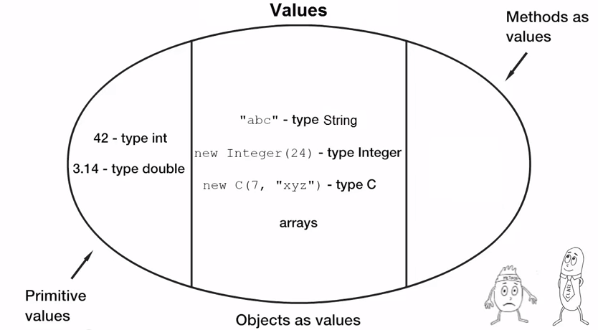
FP - Method references
Java 7:
predicate

Slide 69
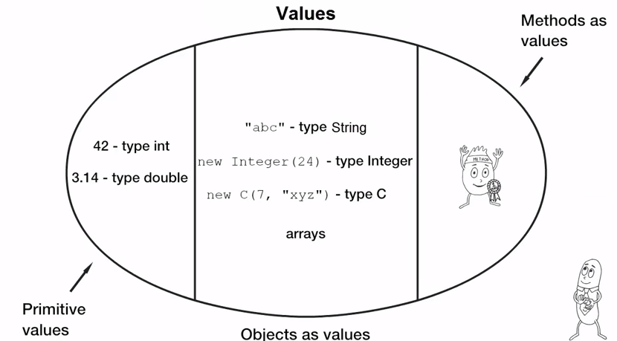
FP - Method references
Java 8:
predicate

Slide 70
FP - Method references
Apple isGreen method:
public class Apple {
private String color;
private int weight;
public boolean isGreen() {
return color.equals(“green”);
}
}
List<Apple> greenApples = filterApples(inventory, apple::isGreen );
predicate

Slide 71
FP - Method references
Apple isGreen method:
public class Apple {
private String color;
private int weight;
public boolean isGreen() {
return color.equals(“green”);
}
}
List<Apple> greenApples = filterApples(inventory, apple::isGreen );
predicate
Reference to isGreen method in Apple class

Slide 72
FP - Method references
Reference to a static method:
Apple::isGreen
Reference to an instance method: apple::isGreen
Reference to a constructor:
Apple::new

Slide 73
Functional Interface
So, How does it work?

Slide 74
Functional Interface
So, How does it work?
Java 8 introduces the “Functional Interface”.
This is an interface with only one abstract method.
This is called SAM (Single Abstract Method).

Slide 75
Functional Interface
So, How does it work?
Java 8 introduces the “Functional Interface”.
This is an interface with only one abstract method.
This is called SAM (Single Abstract Method).
The abstract method implementation is received later by lambda or by a reference to a method.

Slide 76
Functional Interface
Java 8 introduces the annotation @FunctionalInterface
@FunctionalInterface
This is a compile time annotation which will cause a compilation error in case of more than one abstract methods.

Slide 77
Functional Interface
Java 8 introduces the annotation @FunctionalInterface
@FunctionalInterface
This is a compile time annotation which will cause a compilation error in case of more than one abstract methods.
A functional interface can have more than one method as long as only one is abstract (others can have default implementations).

Slide 78
Functional Interface
Predicate is a functional interface
@FunctionalInterface
public interface Predicate<T> {
boolean test(T t);
default Predicate<T> negate() {
return (t) -> !test(t);
}
default Predicate<T> or(Predicate<? super T> other) {
return (t) -> test(t) || other.test(t);
}
default Predicate<T> and(Predicate<? super T> other){
return (t) -> test(t) && other.test(t);
}
}

Slide 79
Functional Interface
Predicate is a functional interface
@FunctionalInterface
public interface Predicate<T> {
boolean test(T t);
default Predicate<T> negate() {
return (t) -> !test(t);
}
default Predicate<T> or(Predicate<? super T> other) {
return (t) -> test(t) && other.test(t);
}
default Predicate<T> and(Predicate<? super T> other){
return (t) -> test(t) && other.test(t);
}
}
Single Abstract Method

Slide 80
Functional Interface
In fact, these are functional interfaces too:
interface Comparator<T> { boolean compare(T x, T y); } (int x, int y) → x - y ;
interface FileFilter { boolean accept(File x); } f → f.isDirectory()
interface Runnable { void run(); } () → someCode();
interface ActionListener{ void actionPerformed(ActionEvent ae); } ae -> log.debug(“Got it!”);

Slide 81
Functional Interface
Java 8 presents these new functional interfaces:
Predicate<T>: boolean test(T t); Determine if the input of type T matches some criteria
Consumer<T>: void accept(T t); Accept a single input argument of type T (return nothing)
Supplier<T>: T get(); A factory that return a new instance or a pre-created one
Function<T, R> R apply(T t); Apply a function to the input type T, generating a result of type R

Slide 82
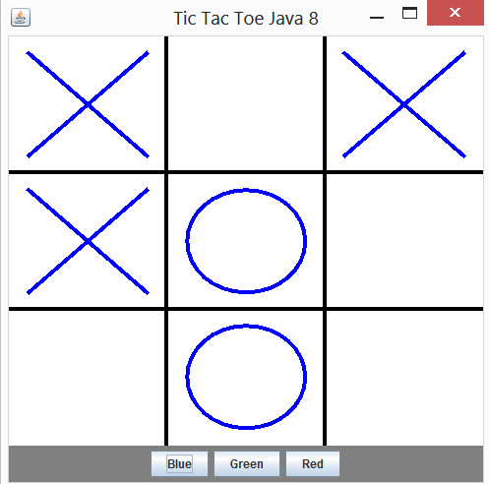
Exercise: Tic Tac Toe

Slide 83
Exercise: Tic Tac Toe
Game: Main class – creates new Thread and runs the game.
TicTacToeFrame: Game Frame. Contains the Board and a panel to switch colors.
State Enum describing cell state: “X” “O” or “BLANK”
Board: Game board. It holds the data in an array of states and draws them to the screen. Click on board cell tries to draw a “X” or a “O” in the chosen color.
No AI and No winner!

Slide 84
Exercise: Tic Tac Toe
Class Game.java
public static void main(String[] args) {
SwingUtilities.invokeLater( new Runnable() {
@Override
public void run() {
new TicTacToeFrame();
}
});
}
Convert it to Java 8 style:

Slide 85
Exercise: Tic Tac Toe
Class Game.java
public static void main(String[] args) {
SwingUtilities.invokeLater( new Runnable() {
@Override
public void run() {
new TicTacToeFrame();
}
});
}
Convert it to Java 8 style:
public static void main(String[] args) {
SwingUtilities.invokeLater(() -> new TicTacToeFrame() );
}

Slide 86
Exercise: Tic Tac Toe
2) Class TicTacToeFrame.java
green.addActionListener(new ActionListener() {
@Override
public void actionPerformed(ActionEvent e) {
board.setColor(Color.GREEN);
}
});
blue.addActionListener(new ActionListener() {
@Override
public void actionPerformed(ActionEvent e) {
board.setColor(Color.blue);
}
});
Convert to Java 8 style:
red.addActionListener(new ActionListener() {
@Override
public void actionPerformed(ActionEvent e){
board.setColor(Color.RED);
}
});

Slide 87
Exercise: Tic Tac Toe
2) Class TicTacToeFrame.java
green.addActionListener(new ActionListener() {
@Override
public void actionPerformed(ActionEvent e) {
board.setColor(Color.GREEN);
}
});
blue.addActionListener(new ActionListener() {
@Override
public void actionPerformed(ActionEvent e) {
board.setColor(Color.blue);
}
});
Convert to Java 8 style:
green.addActionListener( (e) -> board.setColor(Color.GREEN) );
blue.addActionListener( (e) -> board.setColor(Color.BLUE ) );
red.addActionListener( (e) -> board.setColor(Color.RED ) );
red.addActionListener(new ActionListener() {
@Override
public void actionPerformed(ActionEvent e){
board.setColor(Color.RED);
}
});

Slide 88
Exercise: Tic Tac Toe
3) Class Board.java
public class Board extends JPanel implements MouseListener { . . . public void mouseClicked(MouseEvent e) { ... }
@Override
public void mousePressed(MouseEvent e) {}
@Override
public void mouseReleased(MouseEvent e) {}
@Override
public void mouseEntered(MouseEvent e) {}
@Override
public void mouseExited(MouseEvent e) {}
}

Slide 89
Exercise: Tic Tac Toe
3) Class Board.java
public class Board extends JPanel implements MouseListener { . . . public void mouseClicked(MouseEvent e) { ... }
@Override
public void mousePressed(MouseEvent e) {}
@Override
public void mouseReleased(MouseEvent e) {}
@Override
public void mouseEntered(MouseEvent e) {}
@Override
public void mouseExited(MouseEvent e) {}
}
Empty methods !

Slide 90
Exercise: Tic Tac Toe
3) Class Board.java
public class Board extends JPanel implements MouseListener { . . . public void mouseClicked(MouseEvent e) { ... }
@Override
public void mousePressed(MouseEvent e) {}
@Override
public void mouseReleased(MouseEvent e) {}
@Override
public void mouseEntered(MouseEvent e) {}
@Override
public void mouseExited(MouseEvent e) {}
}
Empty methods ! Convert to Java 8 style

Slide 91
Exercise: Tic Tac Toe
3) Class TicTacToe.java
We would like to bind the board and the mouse event and pass a callback function:
board.addMouseListener({callback function});

Slide 92
Exercise: Tic Tac Toe
3) Class TicTacToe.java
We would like to bind the board and the mouse event and pass a callback function:
board.addMouseListener({callback function});
But MouseListener cannot except lambdas and method references (it is not a functional interface).

Slide 93
Exercise: Tic Tac Toe
3) Class TicTacToe.java
We would like to bind the board and the mouse event and pass a callback function:
board.addMouseListener({callback function});
But MouseListener cannot except lambdas and method references (it is not a functional interface).
We’ll create a new functional interface that extends MouseListener and provides defender methods for all the unused mouse events. Only mouseClicked methods will remain abstract (and it will be passed via lambda or method reference).

Slide 94
Exercise: Tic Tac Toe
3) Class MouseClickedListener.java
@FunctionalInterface
public interface MouseClickedListener extends MouseListener {
}

Slide 95
Exercise: Tic Tac Toe
3) Class MouseClickedListener.java
@FunctionalInterface
public interface MouseClickedListener extends MouseListener {
public void mouseClicked(MouseEvent e);
public default void mousePressed(MouseEvent e) {}
public default void mouseReleased(MouseEvent e) {}
public default void mouseEntered(MouseEvent e) {}
public default void mouseExited(MouseEvent e) {}
}

Slide 96
Exercise: Tic Tac Toe
3) Class Board.javav
Board class will no longer implement MouseListener interface.
All the unused methods will be removed.
The click handler method should stay in place for it handles the logic.
The constructor can be removed too because we no longer have to register the class as the event listener.
But the class must expose a new method that expects our new functional interface and registers it as a mouse listener.

Slide 97
Exercise: Tic Tac Toe
3) Class Board.javav
Board class will no longer implement MouseListener interface.
All the unused methods will be removed.
The click handler method should stay in place for it handles the logic.
The constructor can be removed too because we no longer have to register the class as the event listener.
But the class must expose a new method that expects our new functional interface and registers it as a mouse listener.

Slide 98
Exercise: Tic Tac Toe
3) Class Board.javav
Board class will no longer implement MouseListener interface.
All the unused methods will be removed.
The click handler method should stay in place for it handles the logic.
The constructor can be removed too because we no longer have to register the class as the event listener.
But the class must expose a new method that expects our new functional interface and registers it as a mouse listener.
public synchronized void addMouseClickedListener(MouseClickedListener l) {
addMouseListener(l);
}

Slide 99
Exercise: Tic Tac Toe
3) Class TicTacToeFrame.java
Now we can pass the board a method that implement the mouseClicked event.

Slide 100
Exercise: Tic Tac Toe
3) Class TicTacToeFrame.java
Now we can pass the board a method that implement the mouseClicked event.
But should we use a lambda expression or a method reference?

Slide 101
Exercise: Tic Tac Toe
3) Class TicTacToeFrame.java
Now we can pass the board a method that implement the mouseClicked event.
But should we use a lambda expression or a method reference?
In this case, the mouseClicked logic is quite intense and it uses data from the board class itself. Therefore will path the board’s mouseClicked method reference.
public TicTacToeFrame() {
}

Slide 102
Exercise: Tic Tac Toe
3) Class TicTacToeFrame.java
Now we can pass the board a method that implement the mouseClicked event.
But should we use a lambda expression or a method reference?
In this case, the mouseClicked logic is quite intense and it uses data from the board class itself. Therefore will path the board’s mouseClicked method reference.
public TicTacToeFrame() { ...
board.addMouseClickedListener(board::mouseClicked); }

Slide 103
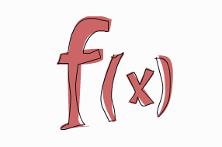
Functional Programming

Slide 104
Functional Programming
Higher order functions: Mathematically: F(G(X))
inventory.sort( (x,y) -> x.getWeight() - y.getWeight() );

Slide 105
Functional Programming
Higher order functions: Mathematically: F(G(X))
inventory.sort( (x,y) -> x.getWeight() - y.getWeight() );
F

Slide 106
Functional Programming
Higher order functions: Mathematically: F(G(X))
inventory.sort( (x,y) -> x.getWeight() - y.getWeight() );
F
G

Slide 107
Functional Programming
Higher order functions: Mathematically: F(G(X))
inventory.sort( (x,y) -> x.getWeight() - y.getWeight() );
Sort() is a higher order function

Slide 108

FP with Streams

Slide 109

FP with Streams
Dishes:
public class Dish {
. . .
String getName() {...}
boolean isVegeterian() {...}
int getCalories() {...}
Type getType() {...}
List<String> getNickNames() {...}
CaloricLevel getCaloricLevel() {...}
}

Slide 110
FP with Streams
Let’s get 3 fat dishes:
List<String> fatDishes = new ArrayList<>();
int count = 0;
for (Dish dish : menu) {
if (count > 3)
break;
if (dish.getCalories() > 300) {
count++;
fatDishes.add(dish.getName());
}
}

Slide 111
FP with Streams
Let’s get 3 fat dishes:
List<String> fatDishes = new ArrayList<>();
int count = 0;
for (Dish dish : menu) {
if (count > 3)
break;
if (dish.getCalories() > 300) {
count++;
fatDishes.add(dish.getName());
}
}
Client code controls the iteration it counts, loops, filters, etc..
Must be serial We cannot run this code parallel without massive changes.
This is not thread-safe Business logic is mutable
This is too imperative

Slide 112
FP with Streams
Let’s get 3 fat dishes:
List<String> fatDishes = new ArrayList<>();
int count = 0;
for (Dish dish : menu) {
if (count > 3)
break;
if (dish.getCalories() > 300) {
count++;
fatDishes.add(dish.getName());
}
}
Client code controls the iteration it counts, loops, filters, etc..
Must be serial We cannot run this code parallel without massive changes.
This is not thread-safe Business logic is mutable
This is too imperative
External iteration

Slide 113
FP with Streams
Using Stream we can do this the “functional way”
Instead of imperatively tell the computer how to do something
We‘ll tell it declaratively what should be done.
List<Dish> menu = new ArrayList<>();
List<String> fatDishes = menu.stream()
.filter(d -> d.getCalories() > 300)
.map(Dish::getName)
.limit(3)
.collect(toList());

Slide 114
FP with Streams
Using Stream we can do this the “functional way”
Instead of imperatively tell the computer how to do something
We‘ll tell it declaratively what should be done.
List<Dish> menu = new ArrayList<>();
List<String> fatDishes = menu.stream()
.filter(d -> d.getCalories() > 300)
.map(Dish::getName)
.limit(3)
.collect(toList());
Get all the dishes that fits the filter

Slide 115
FP with Streams
Using Stream we can do this the “functional way”
Instead of imperatively tell the computer how to do something
We‘ll tell it declaratively what should be done.
List<Dish> menu = new ArrayList<>();
List<String> fatDishes = menu.stream()
.filter(d -> d.getCalories() > 300)
.map(Dish::getName)
.limit(3)
.collect(toList());
Get all the dishes that fits the filter
Consider only the names

Slide 116
FP with Streams
Using Stream we can do this the “functional way”
Instead of imperatively tell the computer how to do something
We‘ll tell it declaratively what should be done.
List<Dish> menu = new ArrayList<>();
List<String> fatDishes = menu.stream()
.filter(d -> d.getCalories() > 300)
.map(Dish::getName)
.limit(3)
.collect(toList());
Get all the dishes that fits the filter
Consider only the names
Return 3 values only

Slide 117
FP with Streams
Using Stream we can do this the “functional way”
Instead of imperatively tell the computer how to do something
We‘ll tell it declaratively what should be done.
List<Dish> menu = new ArrayList<>();
List<String> fatDishes = menu.stream()
.filter(d -> d.getCalories() > 300)
.map(Dish::getName)
.limit(3)
.collect(toList());
Get all the dishes that fits the filter
Consider only the names
Return 3 values only
Gather result to a list

Slide 118
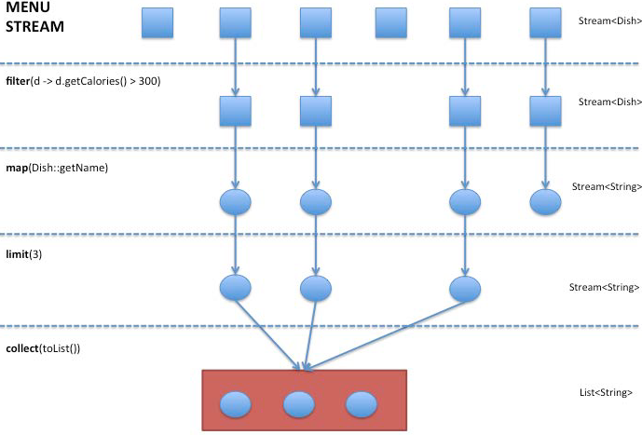
FP with Streams

Slide 119
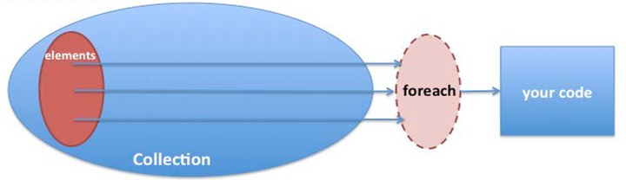
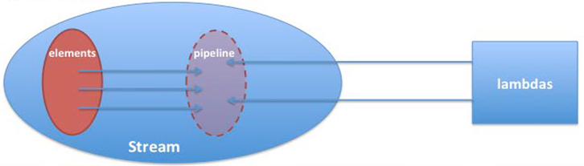
FP with Streams
Collection - External iteration
Stream - Internal Iteration

Slide 120
FP with Streams
Stream: A sequence of elements of a source that supports aggregate operations
Streams are not data-structures.
Their goal is to compute and aggregate.
They consume their data from I/O sources, Arrays and collections.
Support SQL like operations and some other commonly used functionallity such as map, reduce, filter, collect, sort and more.
Streams are immutable – they cannot change the data. Therefore they are thread-safe.
Streams can run parallel (Several cores).
Streams uses pipelines and optimize the operations needed to minimum iterations.

Slide 121
FP with Streams
Creating streams:
IntStream.range(1, 100);
Stream.of("Java 8 ", "Lambdas");
File.list(Paths.get("some-folder"));
Files.lines(Paths.get("data.txt"));
myList.parallelStream();
Stream.iterate(new int[]{0, 1}, t -> new int[]{t[1], t[0]+t[1]})

Slide 122
FP with Streams
Streams high order functions - Map
<R> Stream<R> map (Function<? super T, ? extends R> mapper);
Apply the mapper function on each element of the stream. And generate a new stream of the output by gathering the results of the mapper function.

Slide 123
FP with Streams
Streams high order functions - Map
<R> Stream<R> map (Function<? super T, ? extends R> mapper);
Apply the mapper function on each element of the stream. And generate a new stream of the output by gathering the results of the mapper function.
Stream<String> fatDishes = menu.stream()
.map(Dish::getName)

Slide 124
FP with Streams
Streams high order functions - Map
<R> Stream<R> map (Function<? super T, ? extends R> mapper);
Apply the mapper function on each element of the stream. And generate a new stream of the output by gathering the results of the mapper function.
Stream<String> fatDishes = menu.stream()
.map(Dish::getName)
Convert a stream of Dishes to names stream

Slide 125
FP with Streams
Streams high order functions - Map
Collection of Dishes
Dish
Dish
Dish
Dish
Map
Collection of Strings
Dish Name
Dish Name
Dish Name
Dish Name

Slide 126
FP with Streams
Streams high order functions - Flat Map
<R> Stream<R> faltMap( Function<? super T, ? extends Stream<? extends R>> mapper);
Apply the mapper function on each element of the stream. And generate a new stream of the output by gathering the result of the inner streams content.

Slide 127
FP with Streams
Streams high order functions - Flat Map
<R> Stream<R> faltMap( Function<? super T, ? extends Stream<? extends R>> mapper);
Apply the mapper function on each element of the stream. And generate a new stream of the output by gathering the result of the inner streams content.
menu.stream().flatMap(d -> d.getNickNames().stream());

Slide 128
FP with Streams
Streams high order functions - Flat Map
<R> Stream<R> faltMap( Function<? super T, ? extends Stream<? extends R>> mapper);
Apply the mapper function on each element of the stream. And generate a new stream of the output by gathering the result of the inner streams content.
menu.stream().flatMap(d -> d.getNickNames().stream());
Convert a stream of streams of the Dishes nicknames to names stream

Slide 129
FP with Streams
Streams high order functions - Reduce
Optional<T> reduce(BinaryOperator<T> accumulator);
Reduction of all the elements of the stream to one single value.
menu.stream().map((d) -> d.getCalories()) .reduce((result, cals) -> result += cals);

Slide 130
FP with Streams
Streams high order functions - Reduce
Optional<T> reduce(BinaryOperator<T> accumulator);
Reduction of all the elements of the stream to one single value.
menu.stream().map((d) -> d.getCalories()) .reduce((result, cals) -> result += cals);
Sum all calories of the menu

Slide 131
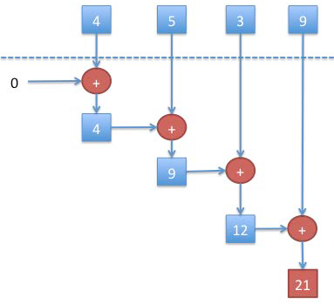
FP with Streams
Streams high order functions - Reduce

Slide 132
FP with Streams
Streams high order functions - Filter
Stream<T> filter(Predicate<? super T> predicate)
Gather a stream of all the elements that match a given predicate.
menu.stream().filter(d -> d.getCalories() > 300);

Slide 133
FP with Streams
Streams high order functions - Filter
Stream<T> filter(Predicate<? super T> predicate)
Gather a stream of all the elements that match a given predicate.
menu.stream().filter(d -> d.getCalories() > 300);
Get a stream of dishes that has more than 300 calories

Slide 134
FP with Streams
Streams high order functions - forEach
void forEach(Consumer<? super T> action);
Apply the action for any member of the stream.
menu.stream().forEach(d -> System.out.println(d.getName()));

Slide 135
FP with Streams
Streams high order functions - forEach
void forEach(Consumer<? super T> action);
Apply the action for any member of the stream.
menu.stream().forEach(d -> System.out.println(d.getName()));
Print all names of all the dishes

Slide 136
FP with Streams
Streams high order functions - more methods:
collect: Convert the final stream to something else using a given collector.
sorted: Returns a new Stream with all the elements sorted by a given comparator.
limit: Returns a new stream with only N elements of the current stream.
anyMatch: Returns true if there at least one element matching a given predicate.
allMatch: Returns true if all the element match a predicate.

Slide 137
FP with Streams
Streams high order functions - more methods:
count: Returns the number of elements in the stream.
distinct: Returns a new Stream with no duplications (using equals method).
skip: Returns a new Stream without the first N elements.
Min / max: Returns the minimum / maximum element using a provided comparator.
Concat: Return a new stream containing elements from two streams.

Slide 138
FP with Streams
Streams high order functions - Group dishes by type (imperative):
Map<Dish.Type, List<Dish>> groupDishesByTypeMap = new HashMap<>();
for (Dish dish : menu) {
final Type type = dish.getType();
List<Dish> dishesForType = groupDishesByTypeMap.get(type);
if(dishesForType == null) {
dishesForType = new ArrayList<>();
groupDishesByTypeMap.put(type, dishesForType);
}
dishesForType.add(dish);
}
return groupDishesByTypeMap;

Slide 139
FP with Streams
Streams high order functions - Group dishes by type (Declerative):
Map<Dish.Type, List<Dish>> groupDishesByTypeMap =
menu.stream().collect(Collectors.groupingBy(Dish::getType));

Slide 140
FP with Streams
Streams high order functions - Group dishes by type (Declerative):
Map<Dish.Type, List<Dish>> groupDishesByTypeMap =
menu.stream().collect(Collectors.groupingBy(Dish::getType));
Pre created static method

Slide 141
FP with Streams
Streams high order functions - examples
Stream lines of all files of “txt“ type
Files.list(Paths.get(“/filesLocation”))
.filter(p -> p.toString().endsWith(“txt”))
.flatMap(Files.lines(path, charset)
.map(this::parse);

Slide 142
FP with Streams
Streams high order functions - examples
Stream lines of all files of “txt“ type
Files.list(Paths.get(“/filesLocation”))
.filter(p -> p.toString().endsWith(“txt”))
.flatMap(Files.lines(path, charset)
.map(this::parse);
Files.list will generate a Stream of Pathes.
We want only “txt” files so we will use filter.

Slide 143
FP with Streams
Streams high order functions - examples
Stream lines of all files of “txt“ type
Files.list(Paths.get(“/filesLocation”))
.filter(p -> p.toString().endsWith(“txt”))
.flatMap(Files.lines(path, charset)
.map(this::parse);
Now we have a Stream of Paths which includes files.
But a file can also be considered as a stream of Strings.

Slide 144
FP with Streams
Streams high order functions - examples
Stream lines of all files of “txt“ type
Files.list(Paths.get(“/filesLocation”))
.filter(p -> p.toString().endsWith(“txt”))
.flatMap(Files.lines(path, charset)
.map(this::parse);
Now we have a Stream of Paths which includes files.
But a file can also be considered as a stream of Strings.
FlatMap will produce one stream of Strings.

Slide 145
FP with Streams
Streams high order functions - examples
Stream lines of all files of “txt“ type
Files.list(Paths.get(“/filesLocation”))
.filter(p -> p.toString().endsWith(“txt”))
.flatMap(Files.lines(path, charset)
.map(this::parse)
Finally, we would like to Parse the lines to our known and convenient object form.

Slide 146
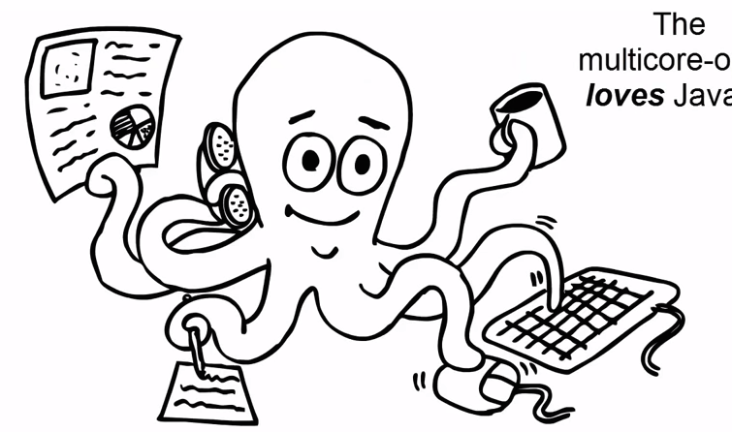
Streams concurrency

Slide 147
Streams concurrency
Streams can also be iterated and processed in a parallel way.
menu.parallelStream().forEach(Dish::heavyCalculation);
The stream will be processed using several threads.
By default, the number of threads is the number of processors.
ParallelStream uses ForkJoin framework behind the scenes.
ParallelStream will not keep the order of the original stream.

Slide 148
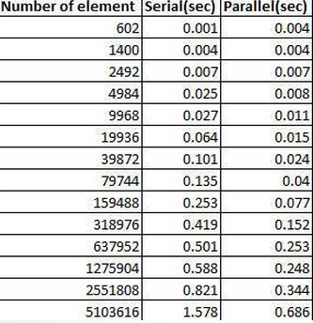
Streams concurrency
Parallel processing should be used only with large scale data:
menu.parallelStream().sorted(Dish::compareTo) Vs menu.stream().sorted(Dish::compareTo)

Slide 149
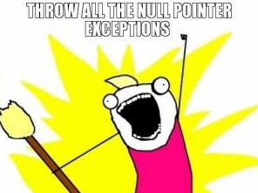
Optionals

Slide 150
Optionals
In order to avoid Null Pointer Exceptions we must check for nulls all the time.
All this checks are causing a messy boiler-plate code:
for example: print all the dishes recommended side-dishes
User user = usersMap.get("userName");
if (user != null) {
Adress address = user.getAddress();
if (address != null) {
City city = address.getCity();
if (city != null) {
System.out.println(city.getName());
}
}
}

Slide 151
Optionals
In order to avoid Null Pointer Exceptions we must check for nulls all the time.
All this checks are causing a messy boiler-plate code:
for example: print the user’s city name
User user = usersMap.get("userName");
if (user != null) {
Adress address = user.getAddress();
if (address != null) {
City city = address.getCity();
if (city != null) {
System.out.println(city.getName());
}
}
}
Boilerplate null checks

Slide 152
Optionals
An optional is an object that can either contain a value or be empty.
An Optional can be considered as a Collection with only one element.
Optional interface exposes some nice methods to avoid the boilerplate:
Get return the value if present, throw NoSuchElement if not.
ifPresent apply given method only if not null
OrElse Return current value if present, other wise return given object.
OrElseThrow Return current value if present, Throw a custom exception if not
Optionals are also called Monads in other languages.

Slide 153
Optionals
Print city name (without optional):
City city = getCity(...);
if (city != null) {
System.out.println(city.getName());
}
Print city name (with optional):
Optional<City> city = getCity(...);
city.ifPresent(ct -> System.out.println(ct.getName()));

Slide 154
Optionals
Optionals can be filtered:
city .filter(ct -> c.getSize() > 30000) .ifPresent(ct -> System.out.println(ct.getName()));
If the dish present and has more than 300 calories it will be returns,
If not, NoSuchElement exception will be thrown.

Slide 155
Optionals
Optionals can be mapped:
String cityName = city.map(ct -> ct.getName()).get();
The map (or flatMap) function will return a new optional with the mapped value.

Slide 156
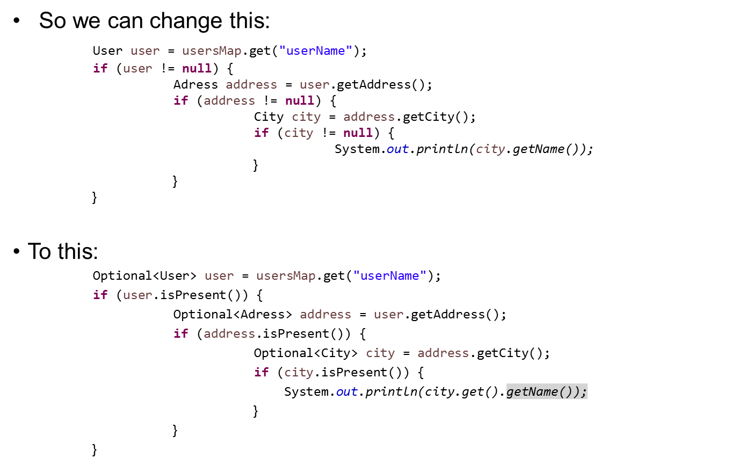
Optionals

Slide 157
Optionals

Slide 158
Optionals
No Null checks!!!

Slide 159
Optionals
No Null checks!!! But is it really better?

Slide 160
Optionals
No!!!
Optionals are built for functional programming.

Slide 161
Optionals
No!!!
Optionals are built for functional programming.
The proper way to get the user’s city name using optionals is this:
Optional<User> user = usersMap.get("userName");
user.map(usr -> usr.getAddress())
.map(address -> address.getCity())
.ifPresent(ct -> System.out.println(ct.getName()));

Slide 162
Optionals
So we can change this: User user = usersMap.get("userName");
if (user != null) {
Adress address = user.getAddress();
if (address != null) {
City city = address.getCity();
if (city != null) {
System.out.println(city.getName());
}
}
}
To this:
Optional<User> user = usersMap.get("userName");
user.map(usr -> usr.getAddress())
.map(address -> address.getCity())
.ifPresent(ct -> System.out.println(ct.getName()));

Slide 163
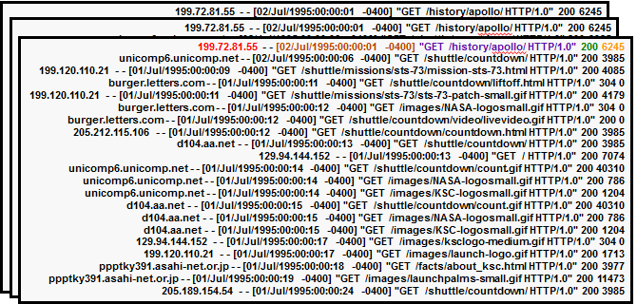

Exercise – Apache logs analysis

Slide 164
Exercise – Apache logs analysis
There are multiple log files in the logs folder.
Log files are very big and cannot be loaded to the memory.
Our job is to analyze the logs.
Do not use try/catch. Just throw exceptions.

Slide 165
Exercise – Apache logs analysis
Project:
Simple Maven project.
LogEntry.java: An entity class to represent a log entry. It has parse method to generate a LogEnrty out of a line according to the log pattern.
LogAnalyiticService: Logics class (which we need to implement).
LogAnaltyicesServiceTest: Test class.

Slide 166
Exercise – Apache logs analysis
Count the lines of a log file.
be sure to load only “.log” files.
use Files.list(Paths.get(location)) to get a stream to the files.
public Long findNumberOfLinesInFirstLog() throws IOException {
}

Slide 167
Exercise – Apache logs analysis
Reminder!
Stream lines of all files of “txt“ type
Files.list(Paths.get(“/filesLocation”))
.filter(p -> p.toString().endsWith(“txt”))
.flatMap(Files.lines(path, charset);
.map(this::parse);

Slide 168
Exercise – Apache logs analysis
Count the lines of a log file.
be sure to load only “.log” files.
use Files.list(Paths.get(location)) to get a stream to the files.
public Long findNumberOfLinesInFirstLog() throws IOException {
return Files.list(Paths.get(loggingDir))
.filter(p -> p.toString().endsWith(LOG_EXT))
.limit(1)
.flatMap(this::getLines)
.count();
}

Slide 169
Exercise – Apache logs analysis
Stream all log entries from all logs.
Use LogEntry.parse() method.
If parse fails it returns null – don’t add it to the final stream.
For your convinience, you can catch Exception and throw RuntimeException.
public Stream<LogEntry> streamLogs() {
try {
} catch (Exception e) {
throw new RuntimeException();
}
}

Slide 170
Exercise – Apache logs analysis
Stream all log entries from all logs.
Use LogEntry.parse() method.
If parse fails it returns null – don’t add it to the final stream.
For your convinience, you can catch Exception and throw RuntimeException.
public Stream<LogEntry> streamLogs() {
try {
return Files.list(Paths.get(loggingDir))
.filter(p -> p.toString().endsWith(LOG_EXT))
.flatMap(this::getLines)
.map(LogEntry::parse)
.filter(le -> le != null);
} catch (Exception e) {
throw new RuntimeException();
}
}

Slide 171
Exercise – Apache logs analysis
3. Find all errors.
Use streamLogs() method.
Errors has response code 500 or greater.
public List<LogEntry> findAllErrorLogs() {
}

Slide 172
Exercise – Apache logs analysis
3. Find all errors.
Use streamLogs() method.
Errors has response code 500 or greater.
public List<LogEntry> findAllErrorLogs() {
return streamLogs()
.filter((le) -> le.getResponse() >= 500)
.collect(toList());
}

Slide 173
Exercise – Apache logs analysis
4. Get last 10 errors.
Logs are not sorted.
Last 10 Errors can be listed in one file or maybe in all of them. (Use the the logEntry dateTime)
public List<LogEntry> findLast10ErrorLogs() {
}

Slide 174
Exercise – Apache logs analysis
4. Get last 10 errors.
Logs are not sorted.
Last 10 Errors can be listed in one file or maybe in all of them. (Use the the logEntry dateTime)
public List<LogEntry> findLast10ErrorLogs() {
return streamLogs()
.filter((le) -> le.getResponse() >= 500)
.sorted((le1, le2) -> le2.getDateTime().compareTo(le1.getDateTime()))
.limit(10)
.collect(toList());
}

Slide 175
Exercise – Apache logs analysis
4. Get last 10 errors.
Logs are not sorted.
Last 10 Errors can be listed in one file or maybe in all of them.
public List<LogEntry> findLast10ErrorLogs() {
return streamLogs()
.filter((le) -> le.getResponse() >= 500)
.sorted(Comparator.comparing(LogEntry::getDateTime).reversed()) .limit(10)
.collect(toList());
}

Slide 176
Exercise – Apache logs analysis
4. Get last 10 errors.
Logs are not sorted.
Last 10 Errors can be listed in one file or maybe in all of them.
public List<LogEntry> findLast10ErrorLogs() {
return streamLogs()
.filter((le) -> le.getResponse() >= 500)
.sorted(Comparator.comparing(LogEntry::getDateTime).reversed()) .limit(10)
.collect(toList());
{
Pre-created comparing function

Slide 177
Exercise – Apache logs analysis
5. Were there any empty responses? empty response -> no bytes sent.
Public boolean wereThereEmptyResponses() {
}

Slide 178
Exercise – Apache logs analysis
5. Were there any empty responses? empty response -> no bytes sent.
Public boolean wereThereEmptyResponses() {
return streamLogs().anyMatch( le -> le.getBytesSent() == 0);
}

Slide 179
Exercise – Apache logs analysis
6. Were there any requests after 1995?
Public boolean wereThereEmptyResponses() {
}

Slide 180
Exercise – Apache logs analysis
6. Were there any requests after 1995?
Public boolean wereThereEmptyResponses() {
return streamLogs().anyMatch( le -> le.getDate.getYear() > 1995);
}

Slide 181
Exercise – Apache logs analysis
7. Create a method to check if there any entries that fits a condition.
Public boolean wereThere(Predicate<LogEntry> predicate) {
}

Slide 182
Exercise – Apache logs analysis
7. Create a method to check if there any entries that fits some condition.
Public boolean wereThere(Predicate<LogEntry> predicate) {
return streamLogs().anyMatch(predicate);
}

Slide 183
Exercise – Apache logs analysis
8. Map all log entries by dates.
public Map<LocalDate, List<LogEntry>> mapByDates() {
}

Slide 184
Exercise – Apache logs analysis
8. Map all log entries by dates.
public Map<LocalDate, List<LogEntry>> mapByDates() {
return streamLogs()
.collect(groupingBy(LogEntry::getDate));
}

Slide 185
Exercise – Apache logs analysis
9. Find how many bytes totally were sent
public Optional<Integer> findHowManyBytesSent() {
}

Slide 186
Exercise – Apache logs analysis
9. Find how many bytes totally were sent
public Optional<Integer> findHowManyBytesSent() {
return streamLogs()
.map(le -> le.getByteSent())
.reduce((sum, bytes) -> sum += bytes); }

Slide 187
Exercise – Apache logs analysis
9. Find how many bytes totally were sent
public Optional<Integer> findHowManyBytesSent() {
return streamLogs()
.map(le -> le.getByteSent())
.reduce((sum, bytes) -> sum += bytes); } public Optional<Integer> findHowManyBytesSent() {
return streamLogs()
.map(LogEntry::getByteSent)
.reduce((sum, bytes) -> sum += bytes); }
Using a reference to the getter method is more elegant

Slide 188
Exercise – Apache logs analysis
10. Find how many GET request received
public Long HowManyGets() {
}

Slide 189
Exercise – Apache logs analysis
10. Find how many GET request received
public Long HowManyGets() {
Function<LogEntry, String> parseMethod = le -> {
String request = le.getRequest();
return request.substring(0, request.indexOf(' '));
};
}

Slide 190
Exercise – Apache logs analysis
10. Find how many GET request received
public Long HowManyGets() {
Function<LogEntry, String> parseMethod = le -> {
String request = le.getRequest();
return request.substring(0, request.indexOf(' '));
};
}
Local Function - not a method

Slide 191
Exercise – Apache logs analysis
10. Find how many GET request received
public Long HowManyGets() {
Function<LogEntry, String> parseMethod = le -> {
String request = le.getRequest();
return request.substring(0, request.indexOf(' '));
};
return streamLogs()
.filter(le -> parseMethod.apply(le).equals("GET"))
.count();
}

Slide 192

Date/Time

Slide 193
Date/Time
Current Java Date/Time API is too complex.
Date/Time classes are not consistently defined:
Java.sql.Date and java.util.Date.
Java.util.date include the time and the java.sql.Date is date only.
Some says that the java.sql classes are redundant and this duplication is a very bad design.
There is a lot of mess with the Date/Time formatters and parsers too: SimpleDateFormat, DateFormat, java.text.*.
Calendar and Date classes are mutable (not thread safe – a big issue in java 8).
There is a very poor internationalization support.

Slide 194
Date/Time
The new Date/Time API principles:
Immutability: Parallelism is a big deal.
Separation of concerns: A clear separation of human readable date/time and machine date/time.
Clarity: The methods are clearly defined. Using them will be exactly the same for all Time classes.
Utility operations: All method come with built-in methods for common operations such as plus, minus, format, parse..
Extendable: ISO calendar but can easily use other calendars.

Slide 195
Date/Time
Java.time.LocalDate
Represent a date with default format of yyyy-MM-dd.
Has a nice methods to get and manipulate dates using a different time zone.
Immutable.

Slide 196
Date/Time
Java.time.LocalDate
Get current date: LocalDate today = LocalDate.now();
Get a date:
LocalDate aDate = LocalDate.of(2014, Month.MARCH, 20);
LocalDate.of(2014, 3, 20);
Get date from the base date (1970): LocalDate dateFrom1970 = LocalDate.ofEpochDay(215);

Slide 197
Date/Time
Java.time.LocalDate
Get the date of the 66th day of 2014:
LocalDate hundredDay2014 = LocalDate.ofYearDay(2014, 66);
Add / subtract LocalDate.now().plusDays(65);
LocalDate.now().minusMonths(67);
LocalDate.now().plusYears(4);
Format date:
LocalDate.now().format(DateTimeFormatter.ofPattern("dd.MM.yyyy"));

Slide 198
Date/Time
Java.time.LocalTime
Represent a time with default format of hh:mm:ss.zzz.
Like local date it has time-zone support and a now method
Java.time.DateTime
Represent a full date time with default format of yyyy-MM-dd-HH:mm:ss.zzz.
Has factory method that gets LocalTime and LocalDate.
java.time.Instant
Represent a machine time (unix template). For example: 2014-08-03T20:54:16:07.472Z

Slide 199
Date/Time
Some extras:
Period calculation:
LocalDate today = LocalDate.now();
LocalDate aDate = LocalDate.of(2014, Month.MARCH, 20);
Period period = aDate.until(today);
period.getDays();
Old date/time API support:
Calendar.getInstance().toInstant();
Calendar.getInstance().getTime().toInstant();

Slide 200

No PermGen

Slide 201
No PermGen
The Permanent Generation is a memory section that stores loaded classes info such as (names and structure).
Running out of PermGen space is inevitable. We are all familiar with java.lang.OutOfMemoryError: PermGen exception.
PermGen size can be changed using the flags: PermSize and MaxPermSize
In Java 8, the PermGen is completely removed.
Java 8 introduces a new memory space: the Metaspace.

Slide 202
No PermGen
Metaspace:
Grow automatically by default.
Growth will be linear.
Metaspcae data will be garbage collected.
New two flags:
MetaspaceSize: Define larger metaspaces memory.
MaxMetaspaceSize: Define when the GC will be invoked.

Slide 203


THANK YOU
Ido.barash@tikalk.com

